Slide 1
Unit-3 Physical Layer

Slide 2
Transmission Media
A transmission media can be defined as any medium that can carry information from a source to a destination.
Transmission Media
Guided Media (Wired)
Unguided Media (Wireless)
Twisted-Pair Cable
Coaxial Cable
Fiber Optic Cable
Radio Wave
Microwave
Infrared Wave

Slide 3
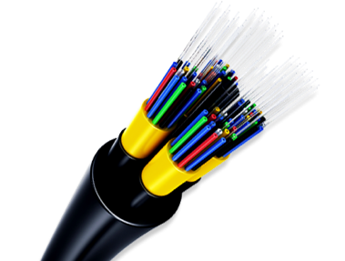
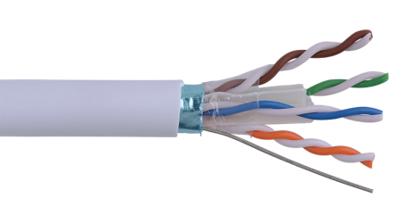
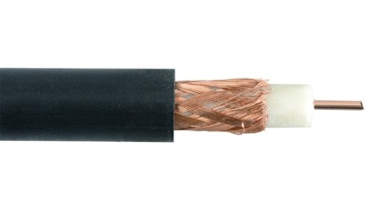
Guided Media
Guided media are those that provide a wired - channel from one device to another.
Three Guided media commonly used for data transmission are:
Twisted Pair Cable
Coaxial Cable
Fiber Optic Cable

Slide 4
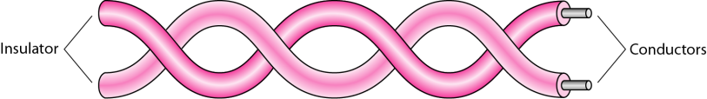
Twisted Pair Cable
It is a physical media made up of a pair of cables twisted with each other.
It is cheap as compared to other transmission media.
Installation of the cable is easy, and it is a lightweight cable.
The frequency range for cable is from 0 to 3.5KHz.
It consists of two insulated copper wires arranged in a regular spiral pattern.
The degree of reduction in noise interference is determined by the number of turns per foot.
Increasing the number of turns per foot decreases noise interference.

Slide 5
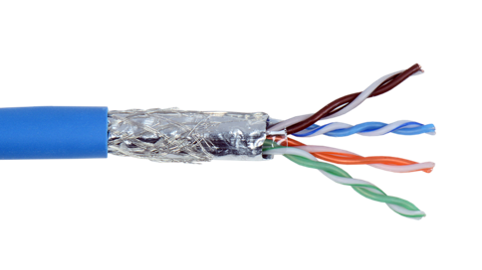
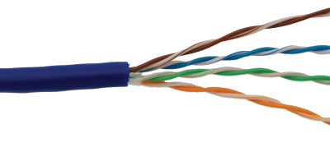
Twisted Pair Cable - Cont.
Separately insulated
It is widely used in different kinds of data and voice infrastructure.
The use of two wires twisted together helps to reduce crosstalk and electromagnetic induction.
Two types of twisted pair cable:
UTP
(Unshielded Twisted Pair)
STP
(Shielded Twisted Pair)

Slide 6
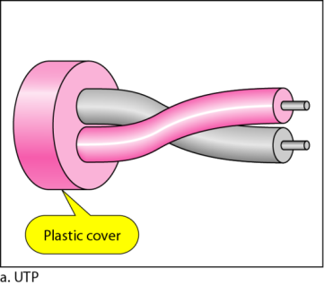
Unshielded Twisted Pair Cable
An unshielded twisted pair is widely used in telecommunication.
Ordinary telephone wires.
Weak immunity against noise & interferences.
Following are the categories of UTP:
Category 1: Used for telephone lines that have low-speed data.
Category 2 & 3 : It can support upto 4Mbps & 16Mbps.
Category 4: It can support upto 20Mbps.
Therefore, it can be used for long-distance communication.
Category 5: It can support upto 200Mbps.
Advantages:
It is cheap.
Installation of the unshielded twisted pair is easy.
It can be used for high-speed LAN.
Disadvantage:
This cable can only be used for shorter distances because of attenuation

Slide 7
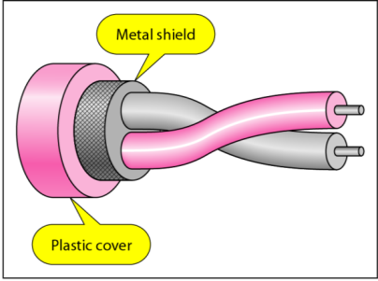
Shielded Twisted Pair Cable
A shielded twisted pair is a cable that contains the mesh surrounding the wire that allows the higher transmission rate.
An installation of STP is easy.
It has a higher attenuation.
It is shielded that provides the higher data transmission rate.
It is more expensive as compared to UTP and coaxial cable.
It has higher capacity as compared to unshielded twisted pair cable.
Used in exterior network(outside of building).

Slide 8
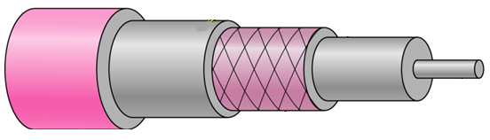
Coaxial Cable
Outer conductor is braided shield.
Inner conductor is solid metal.
Separated by insulating material, and whole cover by plastic cover.
The middle core is responsible for the data transferring whereas the copper mesh prevents from the EMI(Electromagnetic interference).
Insulator
Inner Conductor
Plastic cover
Outer conductor (shield)

Slide 9
Coaxial Cable – Cont.
Used in television, long distance telephone transmission.
It has excellent noise immunity.
It has a higher frequency as compared to Twisted pair cable.
Coaxial cable is of two types:
Baseband transmission:
It is defined as the process of transmitting a single signal at high speed.
Broadband transmission:
It is defined as the process of transmitting multiple signals simultaneously.

Slide 10
Coaxial Cable – Cont.
Advantages Of Coaxial cable:
The data can be transmitted at high speed.
It has better shielding as compared to twisted pair cable.
It provides higher bandwidth.
Disadvantages Of Coaxial cable:
It is more expensive as compared to twisted pair cable.
If any fault occurs in the cable causes the failure in the entire network.

Slide 11
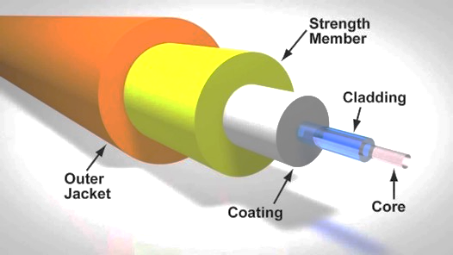
Fiber Optic Cable
A fiber-optic cable is made of glass or plastic and transmits signals in the form of light.
A glass or plastic core is surrounded by a cladding of less dense glass or plastic.
The difference in density of the two materials must be such that a beam of light moving through a core is reflected off the cladding instead of being refracted into it.
Optical fibers use reflection to guide light through a channel.

Slide 12
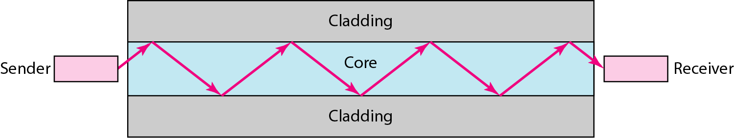
Fiber Optic Cable – Cont.
Core: The optical fibre consists of a narrow strand of glass or plastic known as a core.
Cladding: The concentric layer of glass is known as cladding.
Jacket: The protective coating consisting of plastic is known as a jacket.
Light travels in a straight line as long as it is moving through a single uniform substance.

Slide 13
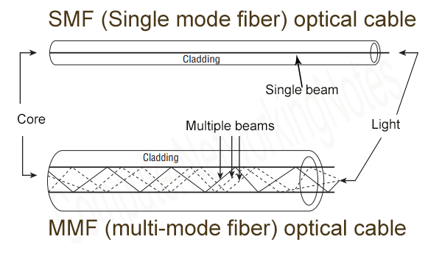
Fiber Optic Cable – Cont.
Based on how many beams of light are transmitted at a given time, there are two types of fiber optical cable : 1. SMF and
2. MMF.

Slide 14
Fiber Optic Cable – Cont.
SMF (Single Mode Fiber) optical cable
This cable carries only a single beam of light.
This is more reliable and supports much higher bandwidth and longer distances than the MMF cable.
This cable uses a laser as the light source and transmits 1300 or 1550 nano-meter wavelengths of light.
MMF (Multi Mode Fiber) optical cable
This cable carries multiple beams of light.
Because of multiple beams, this cable carries much more data than the SMF cable.
This cable is used for shorter distances.
This cable uses an LED as the light source and transmits 850 or 1300 nano-meter wavelengths of light.

Slide 15
Fiber Optic Cable – Advantages
It provide faster data transmission than copper wires.
It carries the data at a longer distance as compared to copper cable.
Small size & weight.
Better Reliability.
Used in high bandwidth network.
High data rate & lower attenuation.

Slide 16
Unguided Media
An unguided transmission transmits the electromagnetic waves without using any physical medium.
Therefore it is also known as wireless transmission.
In unguided media, air is the media through which the electromagnetic energy can flow easily.
This type of communication is often referred to as wireless communication.
Radio wave
Microwave
Infrared Wave

Slide 17
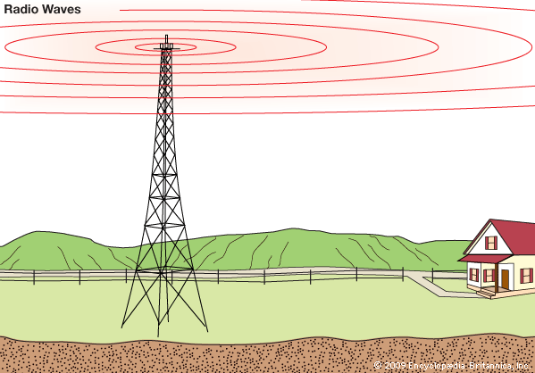
Radio Wave
Radio waves are the electromagnetic waves that are transmitted in all the directions of free space.
Radio waves are omnidirectional.
The signals are propagated in all the directions.
The range in frequencies of radio waves is from 3Khz to 1 khz.
The sending and receiving antenna are not aligned.
The wave sent by the sending antenna can be received by any receiving antenna.
An example of the radio wave is FM radio.

Slide 18
Radio Wave – Cont.
Applications:
A Radio wave is useful for multicasting when there is one sender and many receivers.
An FM radio, television, cordless phones are examples of a radio wave.
Advantages:
Radio transmission is mainly used for wide area networks and mobile cellular phones.
It covers a large area, and they can penetrate the walls.
Radio transmission provides a higher transmission rate.

Slide 19
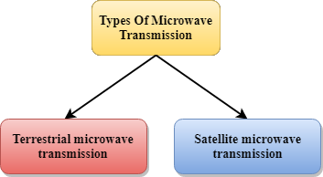
Microwave
Microwaves are of two types:
Use directional antennas - point to point line of sight communications.
Microwave communication.
Used for unicast communication such as cellular telephones, satellite networks.
Higher frequency ranges cannot efficiently penetrate walls.
Frequency Range: 1GHz – 300GHz.

Slide 20
Microwave - Characteristics
Frequency range: The frequency range of terrestrial microwave is from 4-6 GHz to 21-23 GHz.
Bandwidth: It supports the bandwidth from 1 to 10 Mbps.
Short distance: It is inexpensive for short distance.
Long distance: It is expensive as it requires a higher tower for a longer distance.
Attenuation: Attenuation means loss of signal. It is affected by environmental conditions and antenna size.

Slide 21
Microwave – Cont.
Advantages Of Microwave transmission :
Microwave transmission is cheaper than using cables.
It is free from land acquisition as it does not require any land for the installation of cables.
Microwave transmission provides an easy communication in terrains as the installation of cable in terrain is quite a difficult task.
Communication over oceans can be achieved by using microwave transmission.
Disadvantages of Microwave transmission :
Eavesdropping: An eavesdropping creates insecure communication. Any malicious user can catch the signal in the air by using its own antenna.
Out of phase signal: A signal can be moved out of phase by using microwave transmission.
Susceptible to weather condition: A microwave transmission is susceptible to weather condition. This means that any environmental change such as rain, wind can distort the signal.
Bandwidth limited: Allocation of bandwidth is limited in the case of microwave transmission.

Slide 22
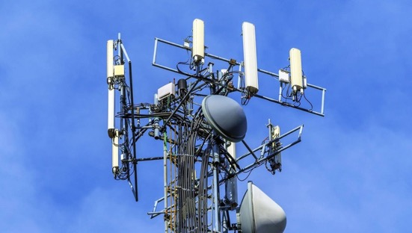
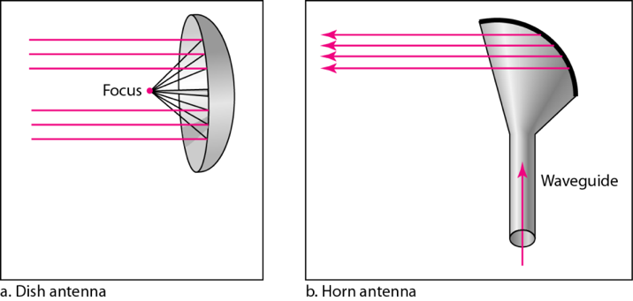
Terrestrial Microwave Transmission
It is a technology that transmits the focused beam of a radio signal from one ground-based microwave transmission antenna to another.
Microwaves are unidirectional as the sending and receiving antenna is to be aligned.
Antennas are mounted on the towers to send a beam to another antenna which is km away.
It works on the line of sight transmission.
The antennas mounted on the towers are the direct sight of each other.

Slide 23
Satellite Microwave Communication – Cont.
Advantages Of Satellite Microwave Communication:
The coverage area of a satellite microwave is more than the terrestrial microwave.
The transmission cost of the satellite is independent of the distance from the centre of the coverage area.
Satellite communication is used in mobile and wireless communication applications.
It is easy to install.
It is used in a wide variety of applications such as weather forecasting, radio/TV signal broadcasting, mobile communication, etc.
Disadvantages Of Satellite Microwave Communication:
Satellite designing and development requires more time and higher cost.
The Satellite needs to be monitored and controlled on regular periods so that it remains in orbit.
The life of the satellite is about 12-15 years. Due to this reason, another launch of the satellite has to be planned before it becomes non-functional.

Slide 24

Infrared wave
An infrared transmission is a wireless technology used for communication over short ranges.
The frequency of the infrared in the range from 300 GHz to 400 THz.
It is used for short-range communication.
For Example, the data transfer between two cell phones, TV remote operation, data transfer between a computer and cell phone resides in the same closed area.

Slide 25
Infrared Wave - Characteristics
Infrared waves cannot penetrate the walls.
Therefore, the infrared communication in one room cannot be interrupted by the nearby rooms.
An infrared communication provides better security with minimum interference.
Infrared communication is unreliable outside the building because the sun rays will interfere with the infrared waves.

Slide 26
Network Interface Card (NIC)
Is a hardware component that is present on the computer.
Used to connect different networking devices such as computers and servers to share data over the connected network.
Provides functionality such as
support for I/O interrupt
Direct Memory Access (DMA) interfaces
partitioning and
data transmission
NIC is important for us to establish a wired or wireless connection over the network.
Also known as Network Interface Controller, Network Adapter, Ethernet card, Connection card, and LAN (Local Area Network) Adapter.

Slide 27
Types of Network Interface Cards
There are two types of NICs -
1. Ethernet NIC
Ethernet NIC was developed by Robert Metcalf in 1980.
It is made by ethernet cables.
This type of NIC is most widely used in the LAN, MAN, and WAN networks.
Example: TP-LINK TG-3468 Gigabit PCI Express Network Adapter.
2. Wireless Networks NIC
It is a wireless network that allows us to connect the devices without using the cables.
These types of NICs are used to design a Wi-Fi connection.
Example: Intel 3160 Dual-Band Wireless Adapter

Slide 28
Repeater
A repeater is a dynamic network device used to reproduce the signals when they transmit over a greater distance so that the signal’s strength remains equal.
A repeater accepts weak signals, electrically regenerates them and then sends the messages on their way.
There are two types of repeaters:
amplifiers and
signal-regenerating repeaters.

Slide 29
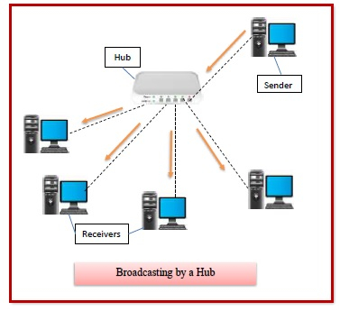
Hub
Hubs are networking devices operating at a physical layer of the OSI model that are used to connect multiple devices in a network.
Used to connect computers in a LAN.
A hub has many ports in it.
A computer which intends to be connected
to the network is plugged into one of
these ports.
When a data frame arrives at a port, it is broadcast to every other port, without considering whether it is destined for a particular destination device or not.

Slide 30
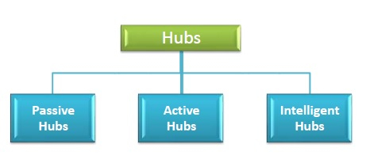
Types of Hub
Initially, hubs were passive devices.
However, with development of advanced technology, active hubs and intelligent hubs came into use.

Slide 31
Types of Hub
Initially, hubs were passive devices.
However, with development of advanced technology, active hubs and intelligent hubs came into use.
Passive Hubs −
Connects nodes in a star configuration by collecting wiring from nodes.
They broadcast signals onto the network without amplifying or regenerating them.
As they cannot extend the distance between nodes, they limit the size of the LAN.

Slide 32
Types of Hub
Active Hubs −
Amplify and regenerate the incoming electrical signals before broadcasting them.
They have their own power supply and serves both as a repeater as well as connecting centre.
Due to their regenerating capabilities, they can extend the maximum distance between nodes, thus increasing the size of LAN.
Intelligent Hubs −
Are active hubs that provide additional network management facilities.
They can perform a variety of functions of more intelligent network devices like network management, switching, providing flexible data rates etc.

Slide 33
Bridge
Bridges are used to connect two subnetworks that use interchangeable protocols. It combines two LANs to form an extended LAN.
Working of Bridges :
A bridge accepts all the packets and amplifies all of them to the other side.
The bridges are intelligent devices that allow the passing of only selective packets from them.
A bridge only passes those packets addressed from a node in one network to another node in the other network.

Slide 34
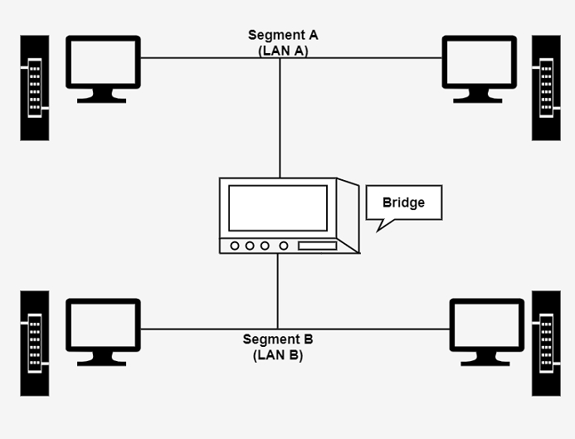
Bridge
A bridge performs in the following aspect −
A bridge receives all the packets or frame from
both LAN (segment) A and B.
A bridge builds a table of addresses from which
it can identify that the packets are sent from
which LAN (or segment) to which LAN.

Slide 35
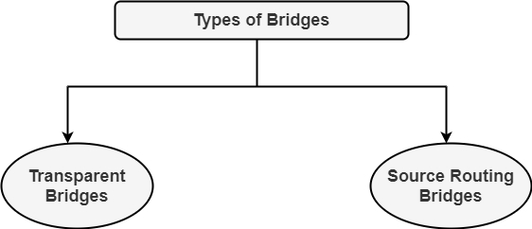
Types of Bridges
There are generally two types of bridges which are as follows −

Slide 36
Types of Bridges
Transparent Bridges
It is also called learning bridges.
Bridge construct its table of terminal addresses on its own as it implements connecting two LANs.
It facilitates the source location to create its table.
It is self-updating. It is a plug and play bridge.
Source Routing Bridge
This sending terminal means the bridges that the frames should stay.
This type of bridge is used to prevent looping problem.

Slide 37
Uses of Bridge
The main uses of bridges are −
Bridges are used to divide large busy networks into multiple smaller and interconnected networks to improve performance.
Bridges also can increase the physical size of a network.
Bridges are also used to connect a LAN segment through a synchronous modem relation to another LAN segment at a remote area.

Slide 38
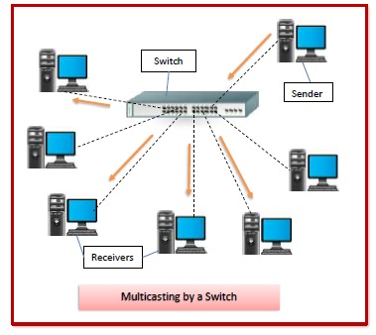
Switch
Switches are networking devices operating at layer 2 or a data link layer of the OSI model.
They connect devices in a network and use
packet switching to send, receive or forward
data packets or data frames over the network.
A switch has many ports, to which computers
are plugged in.
When a data frame arrives at any port of a
network switch, it examines the destination address, performs necessary checks and sends the frame to the corresponding device(s).
It supports unicast, multicast as well as broadcast communications.

Slide 39
Features of Switches
An intelligent network device that can be conceived as a multiport network bridge.
Uses MAC addresses (addresses of medium access control sublayer) to send data packets to selected destination ports.
Uses packet switching technique to receive and forward data packets from the source to the destination device.
Supports unicast (one-to-one), multicast (one-to-many) and broadcast (one-to-all) communications.
Transmission mode is full duplex, i.e. communication in the channel occurs in both the directions at the same time.
Active devices, equipped with network software and network management capabilities.
Switches can perform some error checking before forwarding data to the destined port.

Slide 40
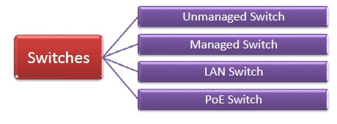
Types of Switches
There are variety of switches that can be broadly categorised into 4 types −

Slide 41
Types of Switches
Unmanaged Switch −
These are inexpensive switches commonly used in home networks and small businesses.
They can be set up by simply plugging in to the network, after which they instantly start operating.
When more devices needs to be added, more switches are simply added by this plug and play method.
They are referred to as unmanaged since they do not require to be configured or monitored.

Slide 42
Types of Switches
Managed Switch −
These are costly switches that are used in organisations with large and complex networks, since they can be customized to augment the functionalities of a standard switch.
The augmented features may be QoS (Quality of Service) like higher security levels, better precision control and complete network management.
Despite their cost, they are preferred in growing organizations due to their scalability and flexibility.
Simple Network Management Protocol (SNMP) is used for configuring managed switches.

Slide 43
Types of Switches
LAN Switch −
Local Area Network (LAN) switches connects devices in the internal LAN of an organization.
They are also referred as Ethernet switches or data switches.
These switches are particularly helpful in reducing network congestion or bottlenecks.
They allocate bandwidth in a manner so that there is no overlapping of data packets in a network.

Slide 44
Types of Switches
PoE Switch −
Power over Ethernet (PoE) switches are used in PoE Gigabit Ethernets.
PoE technology combine data and power transmission over the same cable so that devices connected to it can receive both electricity as well as data over the same line.
PoE switches offer greater flexibility and simplifies the cabling connections.

Slide 45
Router
Router is a particular type of device used to connect two or more subnets that cannot be similar.
These devices support connectedness between two LANs or two WANs over the large geographical range.
The routers evaluate the best route from a sender to a receiver.
They operate at the OSI model’s network layer.
Routers are generally a mixture of hardware and software.
The hardware includes physical interfaces to various networks, while the software consists of operating system and routing protocol.
They use both logical and physical transmitting to link two or more logically separated networks.

Slide 46
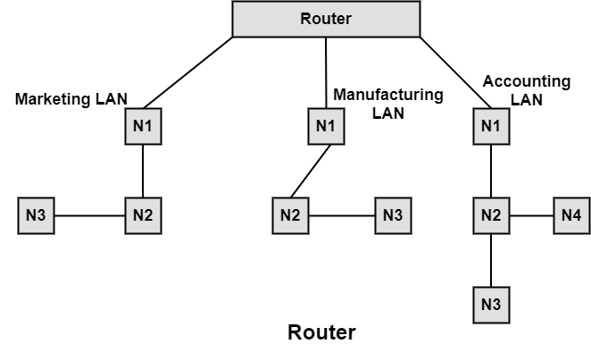
Router
The figure shows three types of LANs connected by a single router.
For this, each network to be connected is allocated
a logical address, and then these logical segments
are combined by the router in a large network.
They use the store and forward technique to
transmit the message,
i.e., receive messages, check their
destination and send the needed LAN message.

Slide 47
Types of Router
There are various types of routers that are as follows −
Central Router
Central router is a router that acts as the backbone of a network. It connects many LANs.
Local Router
The local router has limitations to operate within the limits of its LAN driver’s cable length limitations.
Remote Router
A remote router uses modems or remote connections to connect the LANs beyond its device driver limitations.

Slide 48
Types of Router
Internal Router
Internal router is a part of the network file server, and it routes the data accordingly.
External Router
The external router is located in a workstation on the network.
Peripheral Router
The peripheral router link single LANs to a central router or sometimes to another peripheral router.

Slide 49
Gateway
A gateway is a network node that forms a passage between two networks operating with different transmission protocols.
The most common type of gateways, the network gateway operates at layer 3, i.e. network layer of the OSI (open systems interconnection) model.
However, depending upon the functionality, a gateway can operate at any of the seven layers of OSI model.
It acts as the entry – exit point for a network since all traffic that flows across the networks should pass through the gateway. Only the internal traffic between the nodes of a LAN does not pass through the gateway.

Slide 50
Features of Gateway
Gateway is located at the boundary of a network and manages all data that inflows or outflows from that network.
It forms a passage between two different networks operating with different transmission protocols.
A gateway operates as a protocol converter, providing compatibility between the different protocols used in the two different networks.
The feature that differentiates a gateway from other network devices is that it can operate at any layer of the OSI model.
It also stores information about the routing paths of the communicating networks.
When used in enterprise scenario, a gateway node may be supplemented as proxy server or firewall.
A gateway is generally implemented as a node with multiple NICs (network interface cards) connected to different networks. However, it can also be configured using software.

Slide 51
Types of Gateway
On basis of direction of data flow, gateways are broadly divided into two categories −
Unidirectional Gateways −
They allow data to flow in only one direction.
Changes made in the source node are replicated in the destination node, but not vice versa.
They can be used as archiving tools.
Bidirectional Gateways −
They allow data to flow in both directions. They can be used as synchronization tools.

Slide 52
Types of Gateway
On basis of functionalities, there can be a variety of gateways, the prominent among them are as follows −
Network Gateway −
This is the most common type of gateway that provides an interface between two dissimilar networks operating with different protocols.
Whenever the term gateway is mentioned without specifying the type, it indicates a network gateway.
Cloud Storage Gateway −
It is a network node or server that translates storage requests with different cloud storage service API calls, such as SOAP (Simple Object Access Protocol) or REST (REpresentational State Transfer).
It facilitates integration of private cloud storage into applications without necessitating transfer of the applications into any public cloud, thus simplifying data communication.

Slide 53
Types of Gateway
Internet-To-Orbit Gateway (I2O) −
It connects devices on the Internet to satellites and spacecraft orbiting the earth.
Two prominent I2O gateways are Project HERMES and Global Educational Network for Satellite Operations (GENSO).
IoT Gateway −
IoT gateways assimilates sensor data from IoT (Internet of Things) devices in the field and translates between sensor protocols before sending it to the cloud network.
They connect IoT devices, cloud network and user applications.
VoIP Trunk Gateway −
It facilitates data transmission between plain old telephone service (POTS) devices like landline phones and fax machines, with VoIP (voice over Internet Protocol) network.

